Slide 1
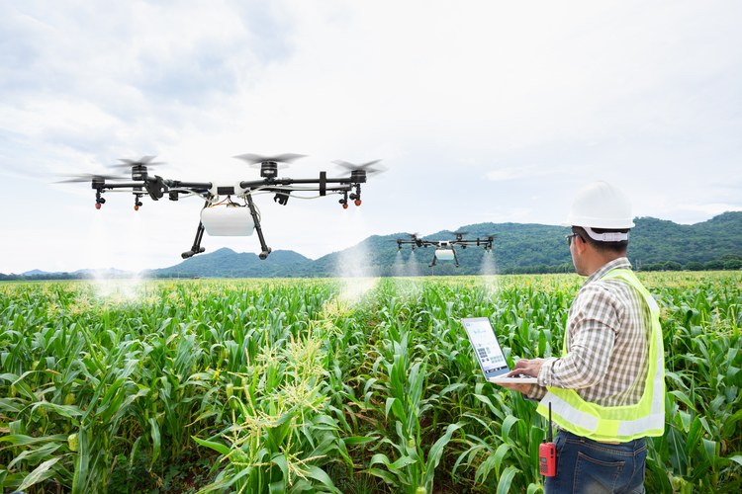
Monitoring crop health using drone images
12.1.2019
Swaroopa Kadam
University of North Texas

Slide 2
Overview
Project aims on studying sugarcane crop by capturing images from the drone.
The images captured by the drone will help the farmers in monitoring the health of the sugarcane plantation.
Convolutional neural network is used to create the image classification model that can detect crop diseases by analyzing the plant leaf images captured by a drone.

Slide 3
Goal
The goal of this project is to create a deep learning-based image classification model that can classify plant leaf images into the following categories:
Healthy leaf.
Infected by rust disease.
Infected by Red Rot disease.
Infected by Leaf scald disease.
Infested by Sugarcane Woolly Aphid.

Slide 4
Diseases found in sugarcane crop
Rust disease
Sugarcane Woolly Aphid
Red rot disease
Leaf scald disease

Slide 5
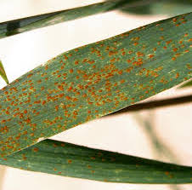
Rust disease
Sugarcane rust is caused by the pathogen Puccinia Melanocephala.
This disease can be identified by the small red spots about 1mm to 4mm in length
The spots on leaves are elongated lengthwise and starts turning reddish-brown in color.

Slide 6
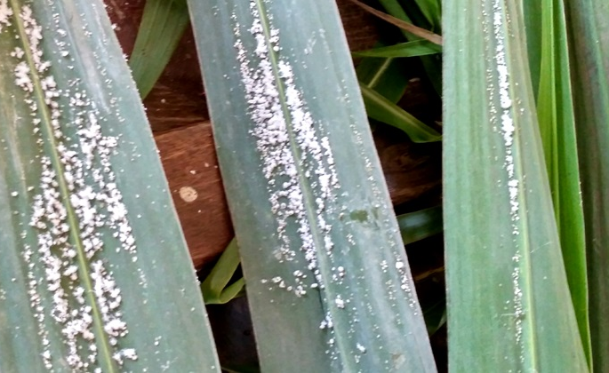
Sugarcane Woolly Aphid
Sugarcane wooly aphid is a pest that sucks healthy green leaves.
Aphids are small sap-sucking insects that have a white and fluffy appearance.
Leaves become brittle and dries completely.

Slide 7
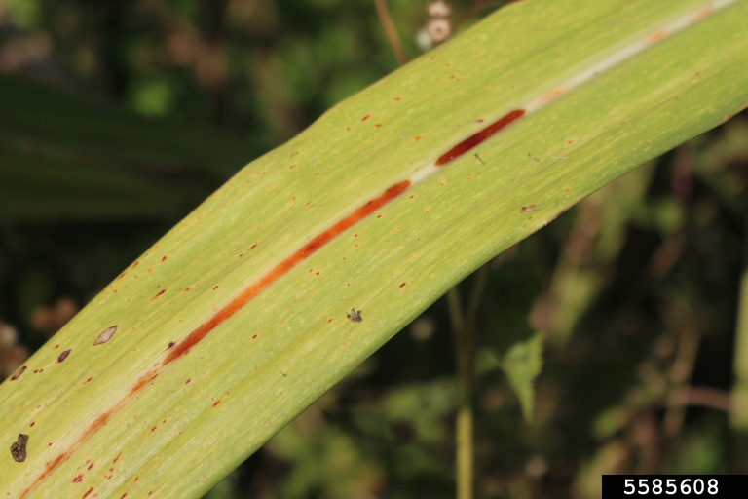
Red rot disease
This disease is caused by the fungus Colletotrichum Falcatum.
The affected leaf appears to have reddish lesions. These lesions are 2 to 3 mm in length and about 0.5 mm in width.
the entire crop is destroyed within a few days due to this disease

Slide 8
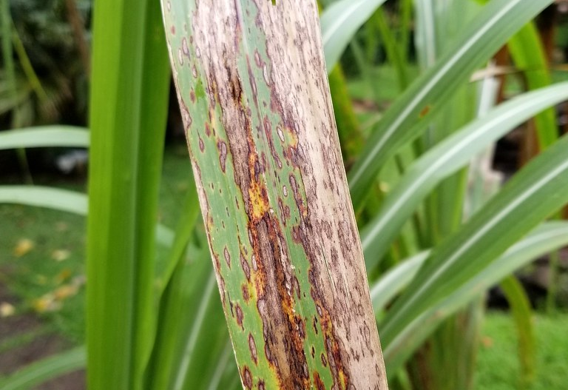
Leaf scald disease
Leaf scald is a fungal disease, this disease is caused by a fungal pathogen called Microdochium Oryzae.
It can be identified by dark brown patches that are found on the leaf surface of the sugarcane plant.
These patches are about 1−5 cm long and 0.5−1 cm wide or may almost cover the entire leaf.
The leaves affected by this disease dry out and give a scalded appearance.

Slide 9
Research question Can an image classification model effectively detect Sugarcane plant diseases?
Research Question And Hypothesis
Null Hypothesis
An image classification model cannot effectively detect sugarcane plant disease based on the image of the plant leaf.
Alternate Hypothesis
Using deep-learning modeling techniques, we can build a model that can effectively detect sugarcane plant diseases based on the image of the leaf.

Slide 10
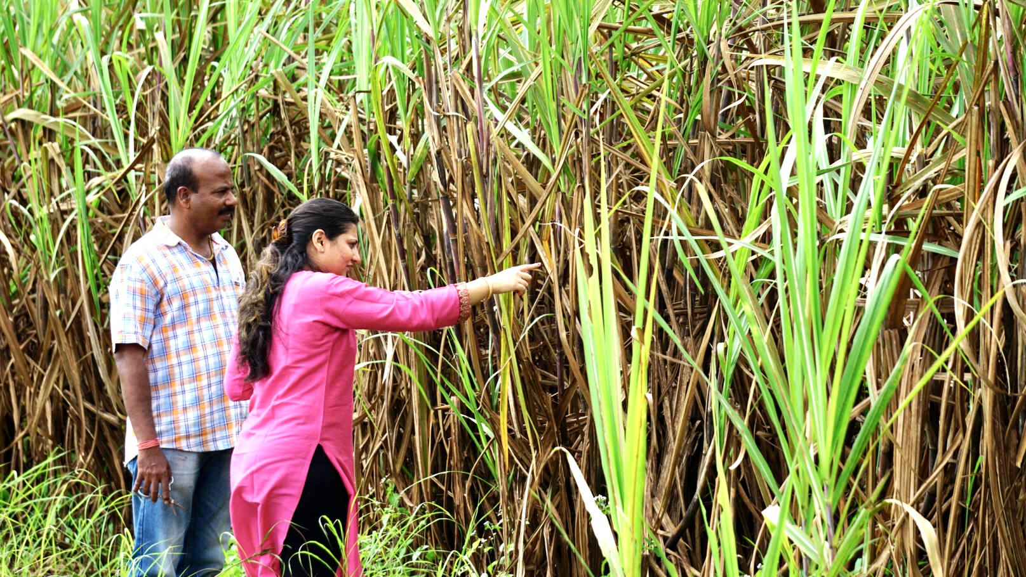
Data collection
18,000 sugarcane leaf images are collected by conducting visits to nearby sugarcane farms and from google images.
The images collected are a mix of infected and healthy leaves.
Around 14745 sugarcane leaf images are used for training the CNN model and 3255 images are used to test the accuracy of the model. This is approximately 80-20 split between testing and training data.

Slide 11
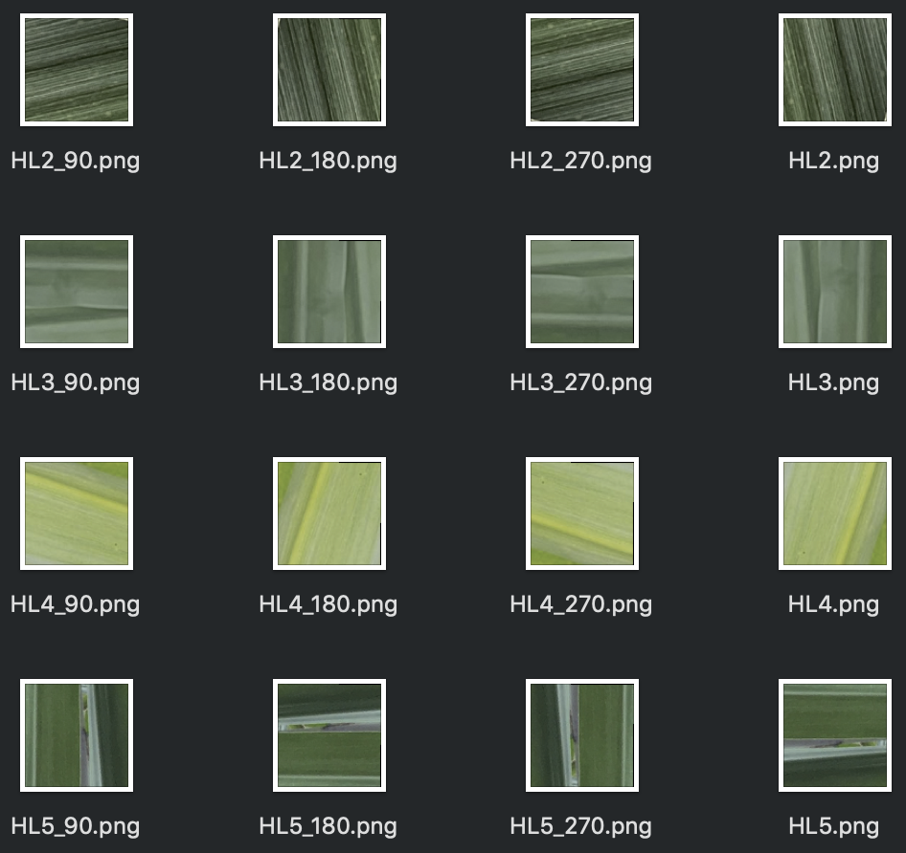
Data preparation
To limit the processing requirements I had to convert the images to the size of 100x100 pixels without losing any details.
Open-CV program was used to re-size the images to 100x100 size.
To reduce any over-fitting due to the orientation of the images, I have rotated the images by 90, 180 and 270 degrees. The file names are appended by _90, _180, _270 to record the orientation change.

Slide 12
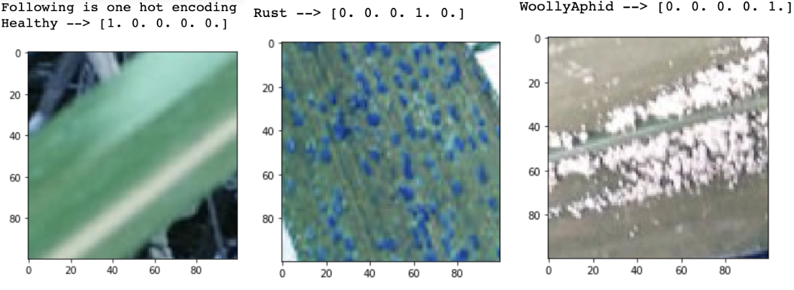
Labeling images using One-hot encoding:
The images are labeled using a one-hot format encoding as required by the CNN modeling technique. This helps in labeling training data with the classification type of the image.
For our image classification model, we will be using the five-digit label as we have 5 categories for classification.

Slide 13
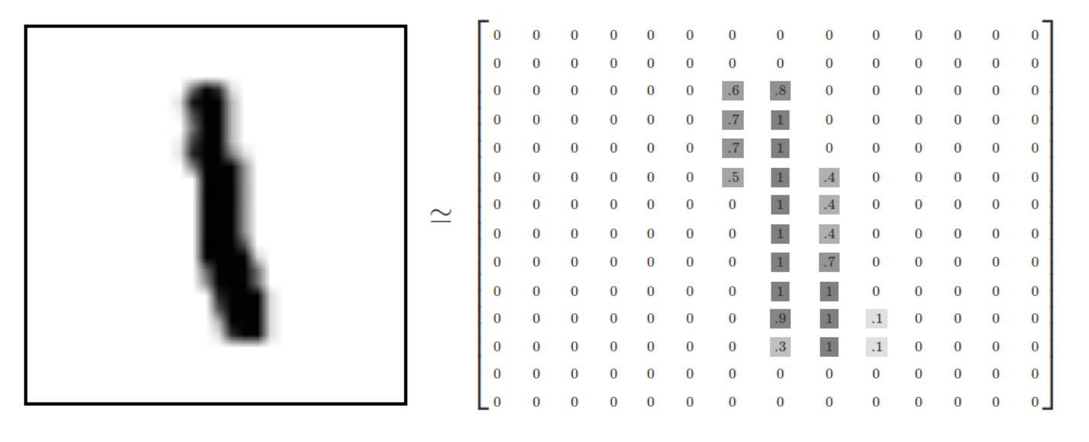
Creating matrix representation for each image.
Matrix representation of an image of number 1
TensorFlow is used for creating CNN model.
We need to convert each image into a tensor of size 100x100x3.
100x100 is the 2-dimensional size of the image and 3 represents the number of channels (e.g. RGB). each pixel is represented by a number in the matrix with a value ranging from 0 to 255.

Slide 14
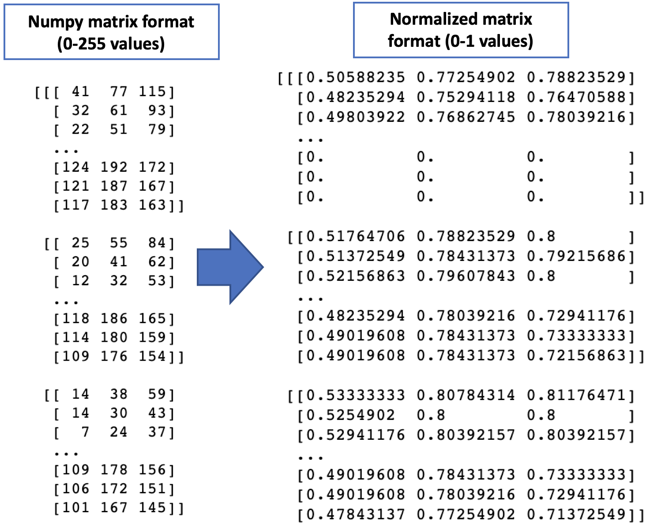
Normalize the image data by dividing with 255
The next pre-processing step was to convert all the numbers in the image tensor to values between 0 and 1.
This was done by dividing each pixel value representation by 255.
After normalization, the training data is ready to be used for training the CNN image classification model.

Slide 15
Reducing Bias by Randomize training data
When the images are imported in the form of a list, all the categories of classification were imported one after the other.
Since each category of the image was clustered together in the training data, there was a risk of generating weights that may be biased . So the image class categories were randomized in the input list to create a mix of categories.
Following python function was used to randomize the input list training_data:
random.shuffle(training_data)

Slide 16
Modeling
Keras TensorFlow library is used to implement the Convolutional Neural Networks (CNN).
A deep learning CNN model takes an image input in the form of a 2-dimensional array of pixels. Each pixel of the image is treated like a number representing the RGB color combination for that.
The CNN model is using training and testing images data in a ratio of around 80%-20%.

Slide 17

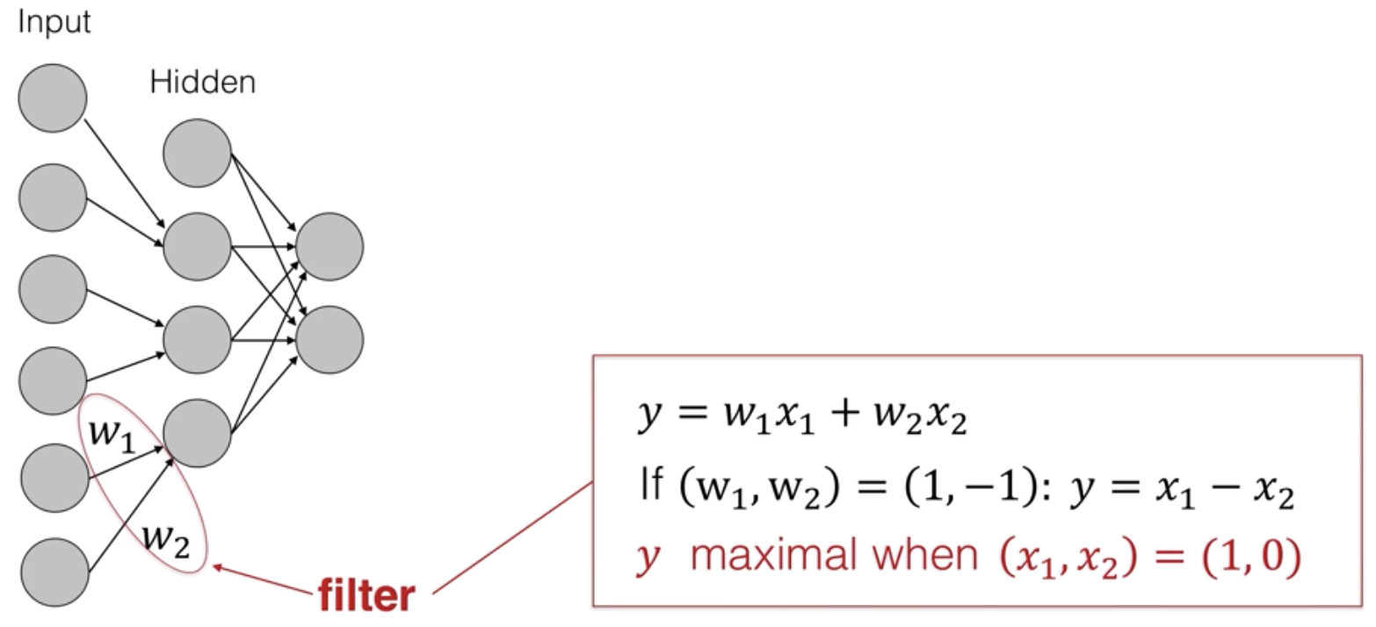
CNN model used

Slide 18
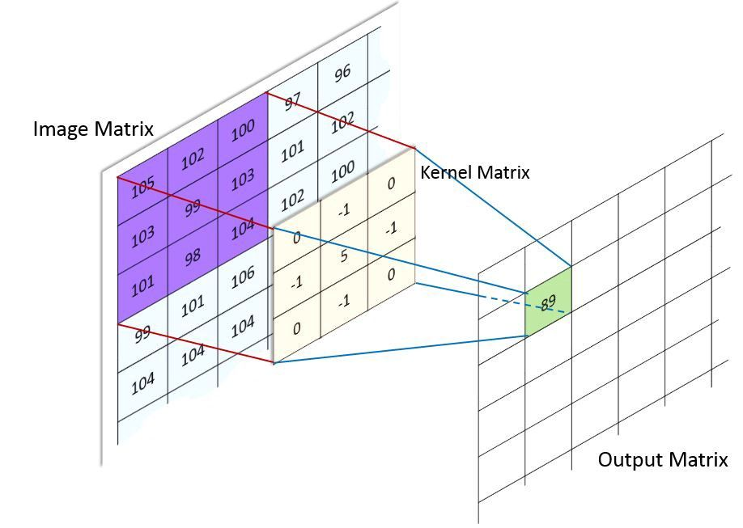
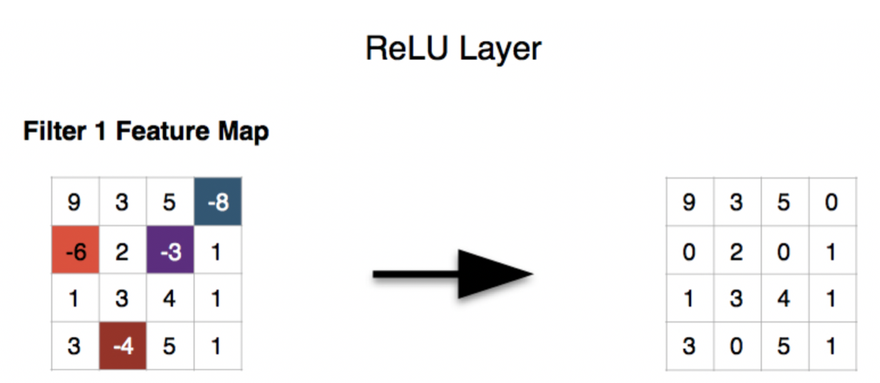
Convolution layer and ReLU layer
Feature Learning Layer

Slide 19
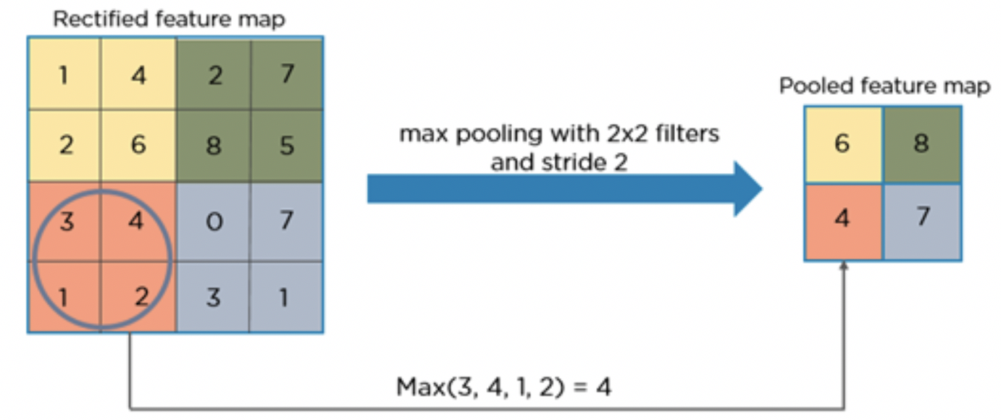
Max pooling
Feature Learning Layer

Slide 20
Flattening Layer
Classification Layers

Slide 21
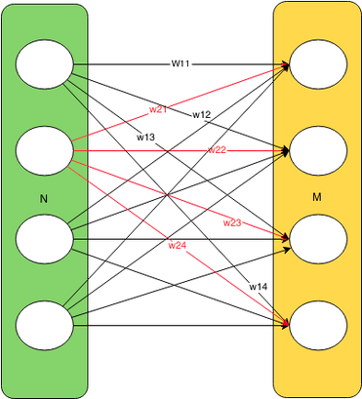
Fully connected layer
Classification Layers

Slide 22
Softmax
Classification Layers

Slide 23
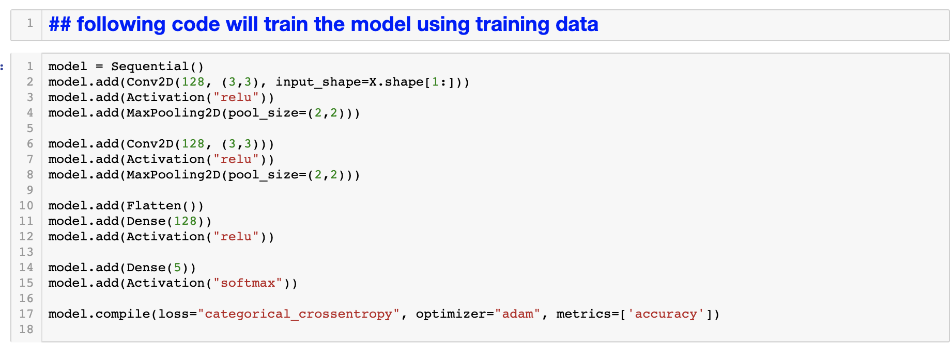
Training the Model

Slide 24
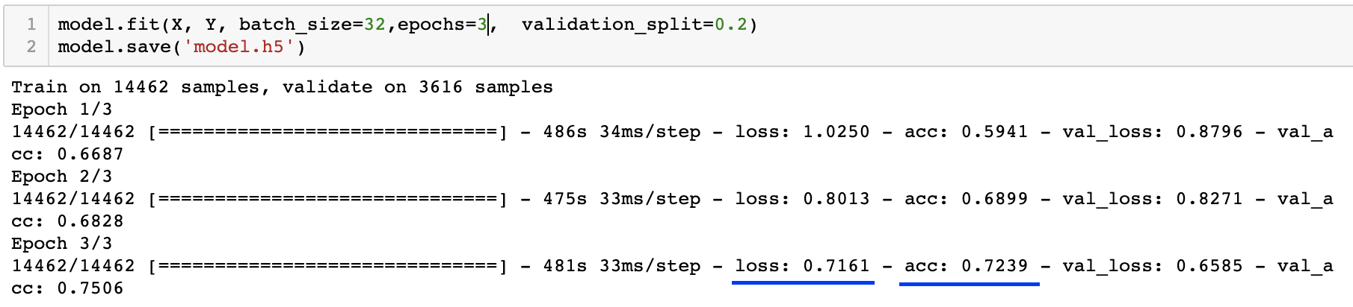
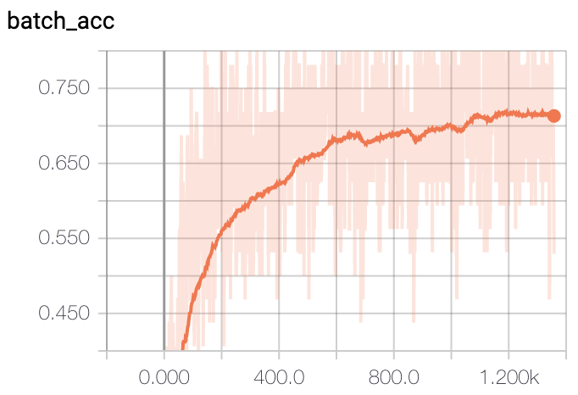
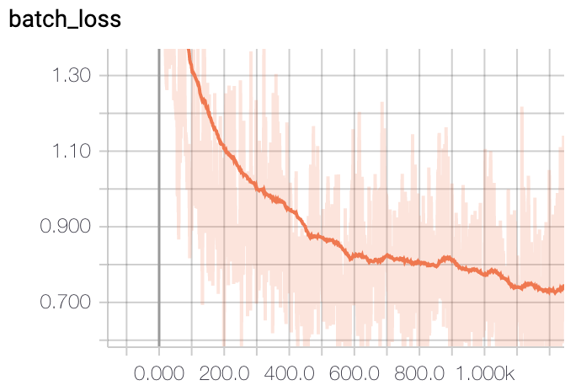
Training with 3 epochs
Model.fit() will perform training of the CNN model using the training images
Model.save() will save the trained model into a file.

Slide 25
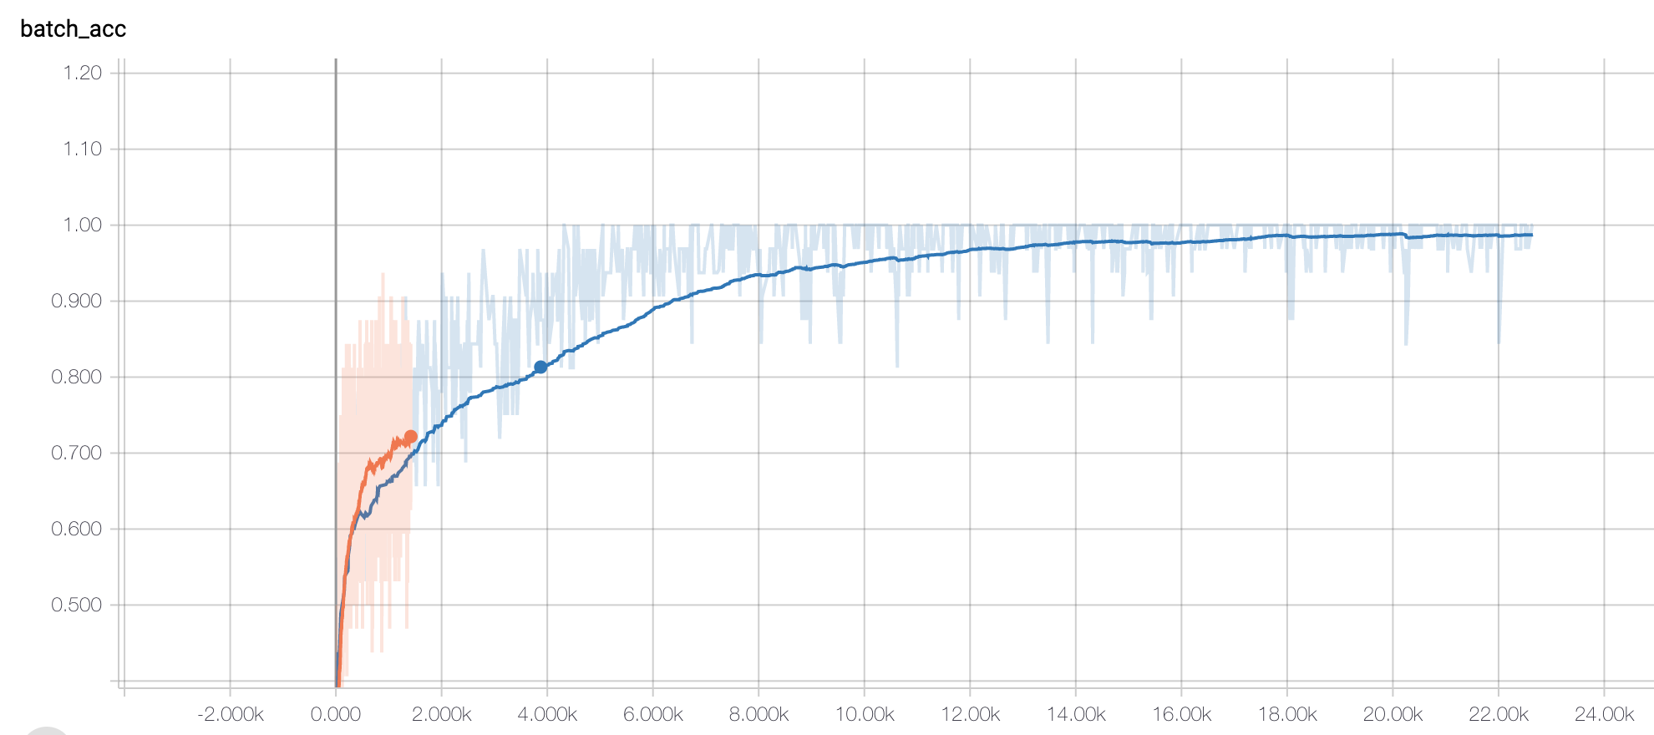
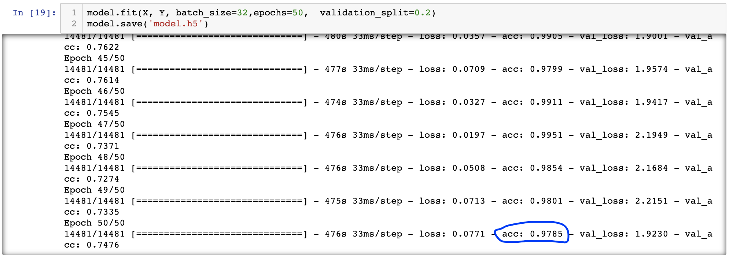
Model Optimization (training with 50 epochs)
Training accuracy increased to 97.85% with 50 epochs
Training Accuracy comparison graph using Tensor-board
Training accuracy with 3 epochs
Training accuracy with 50 epochs

Slide 26
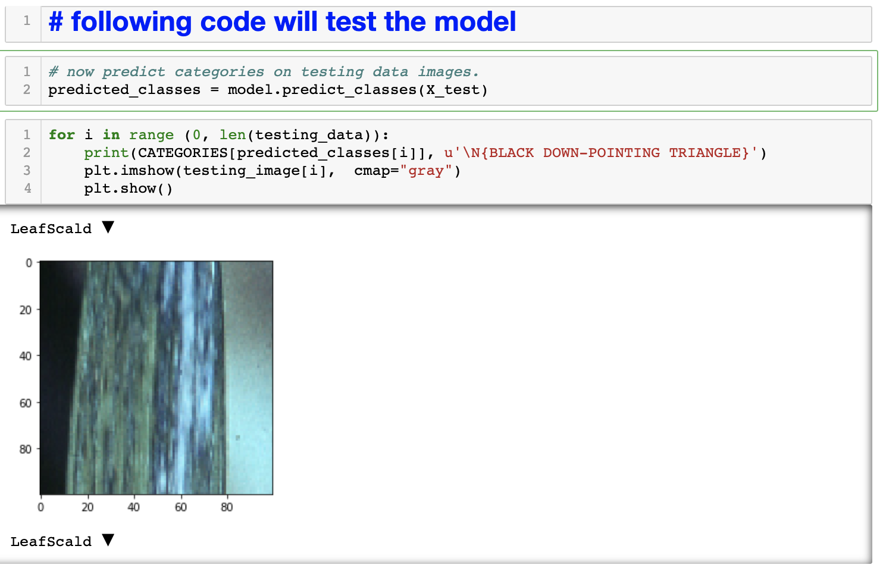
Model testing
I used model.predict_classes() method to get classification for each testing image.
The predicted category with the testing image is displayed in the above screenshot.

Slide 27
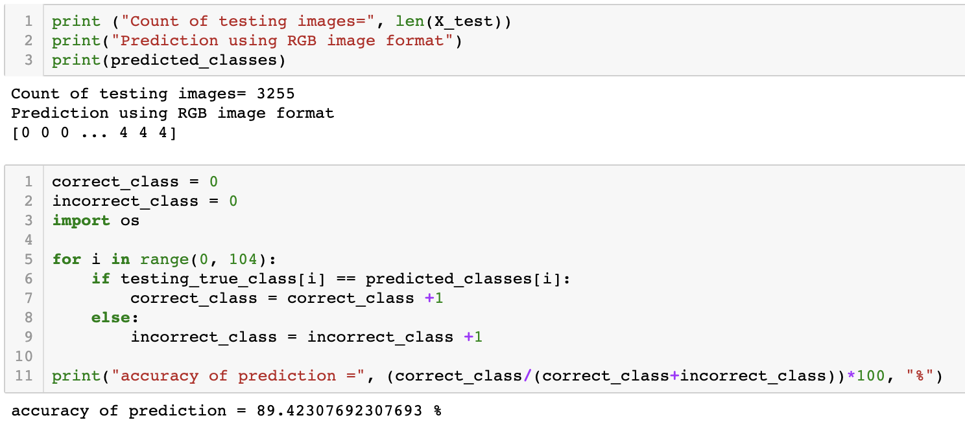
Result of testing of the Image classification model using 3255 testing images

Slide 28
Recommendations
This project used manually cropped images but when using a drone on the field there will be practical challenges of image focusing, lighting, the method used for cropping images, etc. For practical use, it is recommended that a lot of training considering all the possible scenarios should be performed before using this model for commercial purposes.
Recently, high-performance algorithms have been introduced which use CNN underneath but can perform classification on a live video stream from a camera. A few examples are YOLO, Faster RCNN, Masked RCNN, etc. I recommend to try these algorithms as the drone is a fast-moving machine with the limited flight time.

Slide 29
Conclusion
In this project an image classification model was developed for detecting sugarcane plant diseases by analyzing images of sugarcane leaves.
The classification model was optimized by increasing the number of epochs to 50. The training accuracy increased from 72.39% to 97.85%.
When testing this model with a set of 3255 images, the classification accuracy of 89.42% was obtained.
Based on the results we can reject the null hypothesis and accept alternate hypothesis that we can use a CNN based image classification model for detecting sugarcane plant disease by analyzing the images of its leaves.

Slide 30
Thank you

